Slide 1

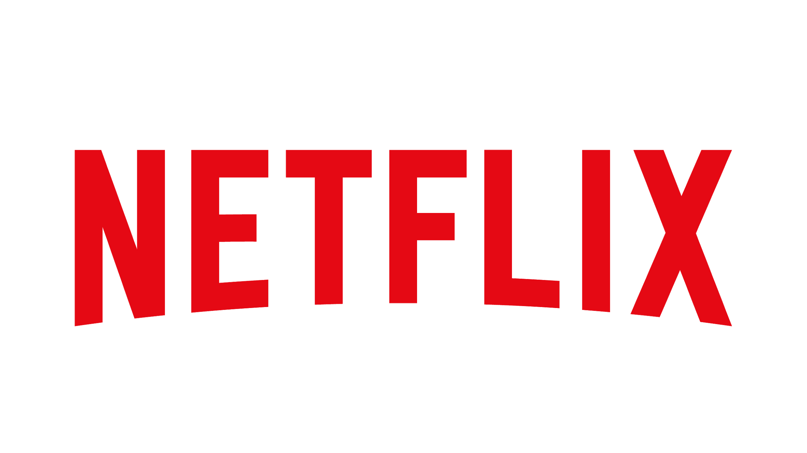

TOP 10 SHOWS ON NETFLIX
SATURDAY DECEMBER 5TH 2020

Slide 2
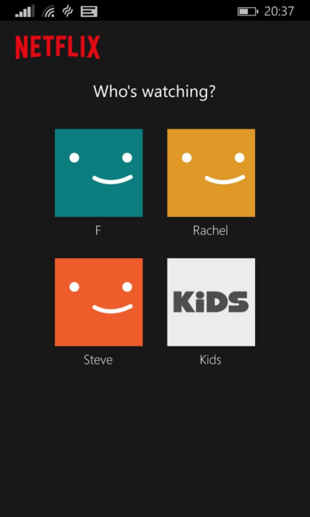
Who’s watching?
Andrea Gonzalez
Lilia Restrepo
Taytumn Schlegel

Slide 3

Coming soon...
Background
Data
Access
Selection
Summary
Modeling
Regression
Decision Trees
Time Series
Clustering
Naive Bayes
Summary

Slide 4
Who is Netflix?
And why them?

Slide 5
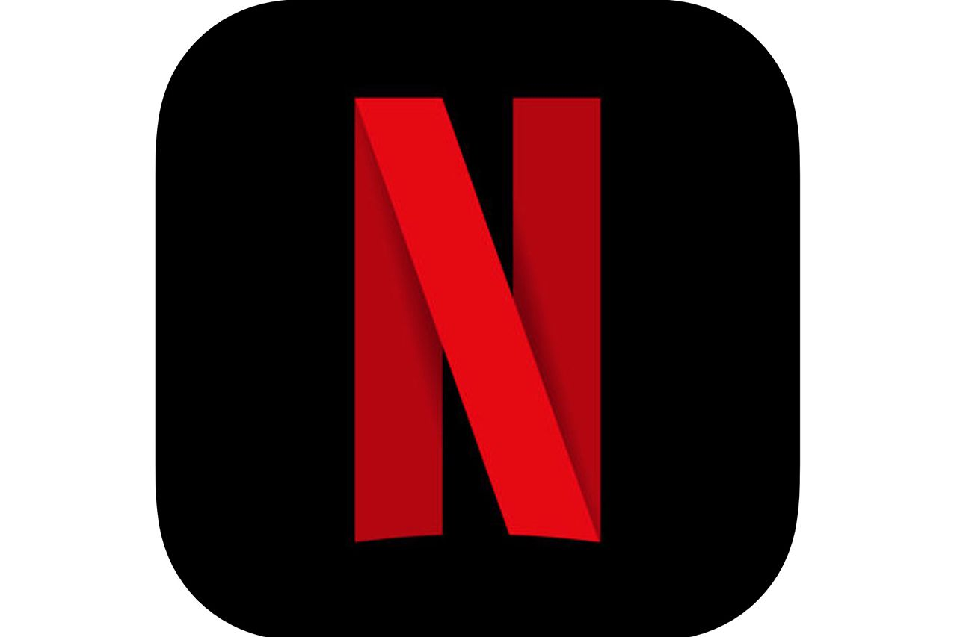
WHO & WHY?
Top streaming service
Users stream 140 million hours of content daily
Caters to the viewer and makes suggestions
Surge in subscribers due to COVID -19

Slide 6
Data
Twitter API access
Selection and collection
Importation
Summary

Slide 7
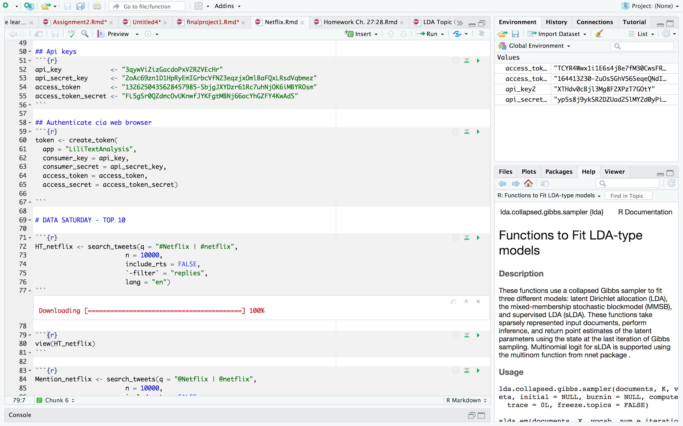
Twitter API Access and data selection

Slide 8
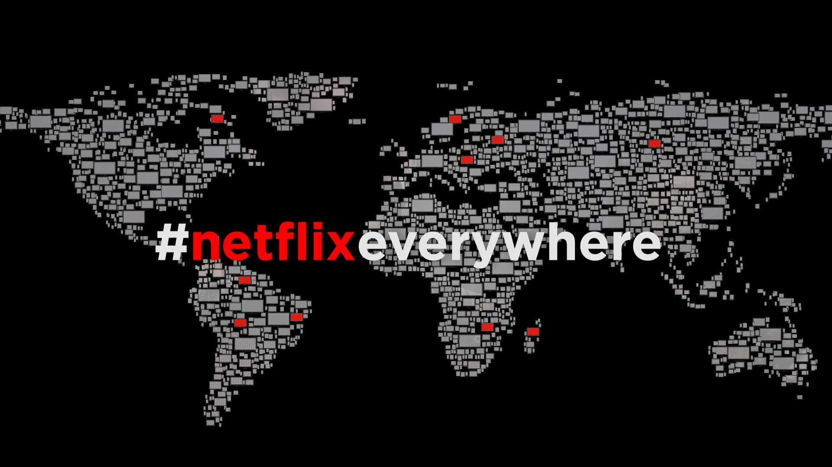
Selection & Collection
Netflix is Popular!
Almost 14,000 Titles
Over 167 Million subscribers
9.9 Million twitter followers

Slide 9
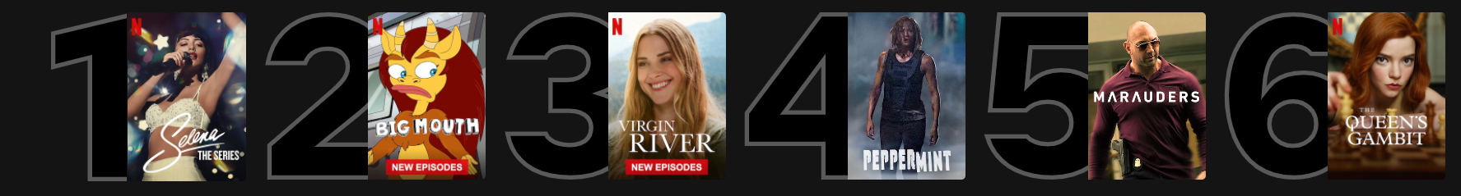
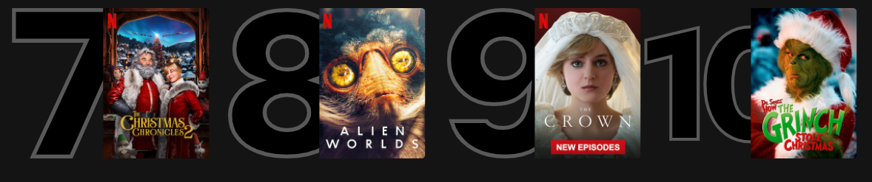
Top 10 in U.S, Saturday, December 5th, 2020

Slide 10
Different ways to gather data by searching the most common hashtags and mentions used in twitter for the top 10 shows in USA
Collection of Data

Slide 11
TITLE | HASHTAGS
Selena : The Series | #SelenaNetflix #selenanetflix #selenatheseries #SelenaTheSeries
Big Mouth | #BigMouth #bigmouth #BigMouthSeason4
Virgin River | #VirginRiver #VirginRiverSeason2 #virginriver
Peppermint | #peppermint & #Netflix
Marauders | #marauders & #Netflix
The Queen’s Gambit | #QueensGambit #TheQueensGambit #queensgambit
Christmas Chronicles | #ChristmasChronicles #christmaschronicles
Alien Worlds | #AlienWorlds #alienworlds
The Crown | #TheCrown #TheCrownNetflix @TheCrownNetflix
The Grinch | #TheGrinch @TheGrinch2000

Slide 12
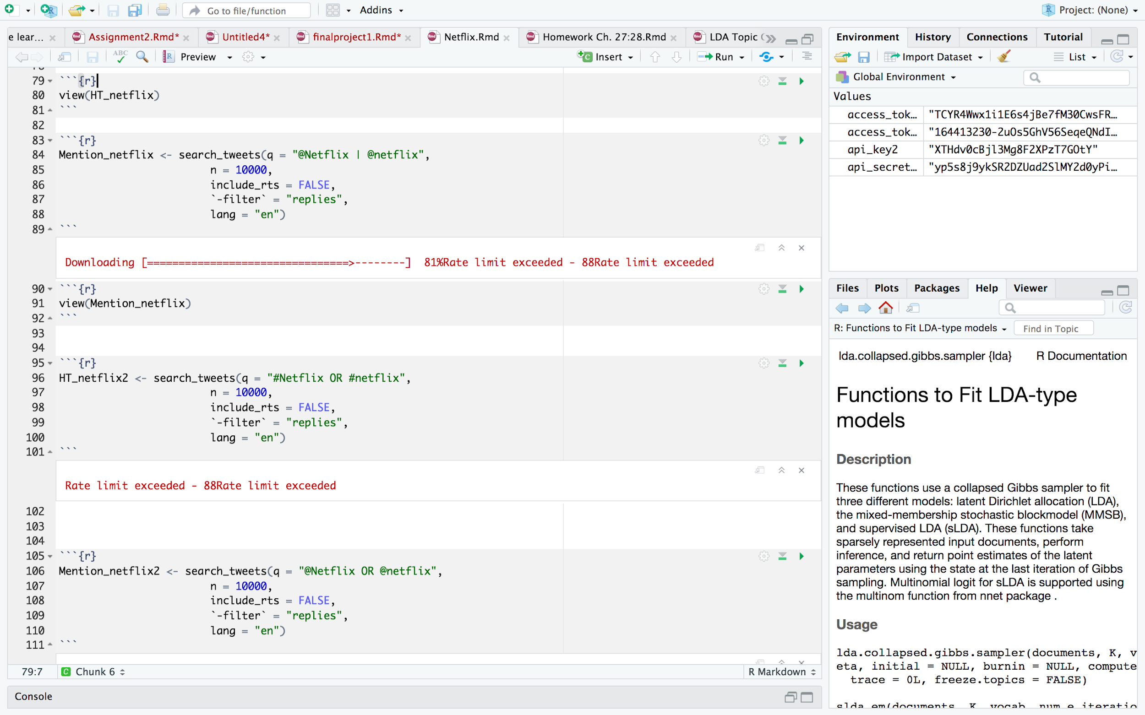
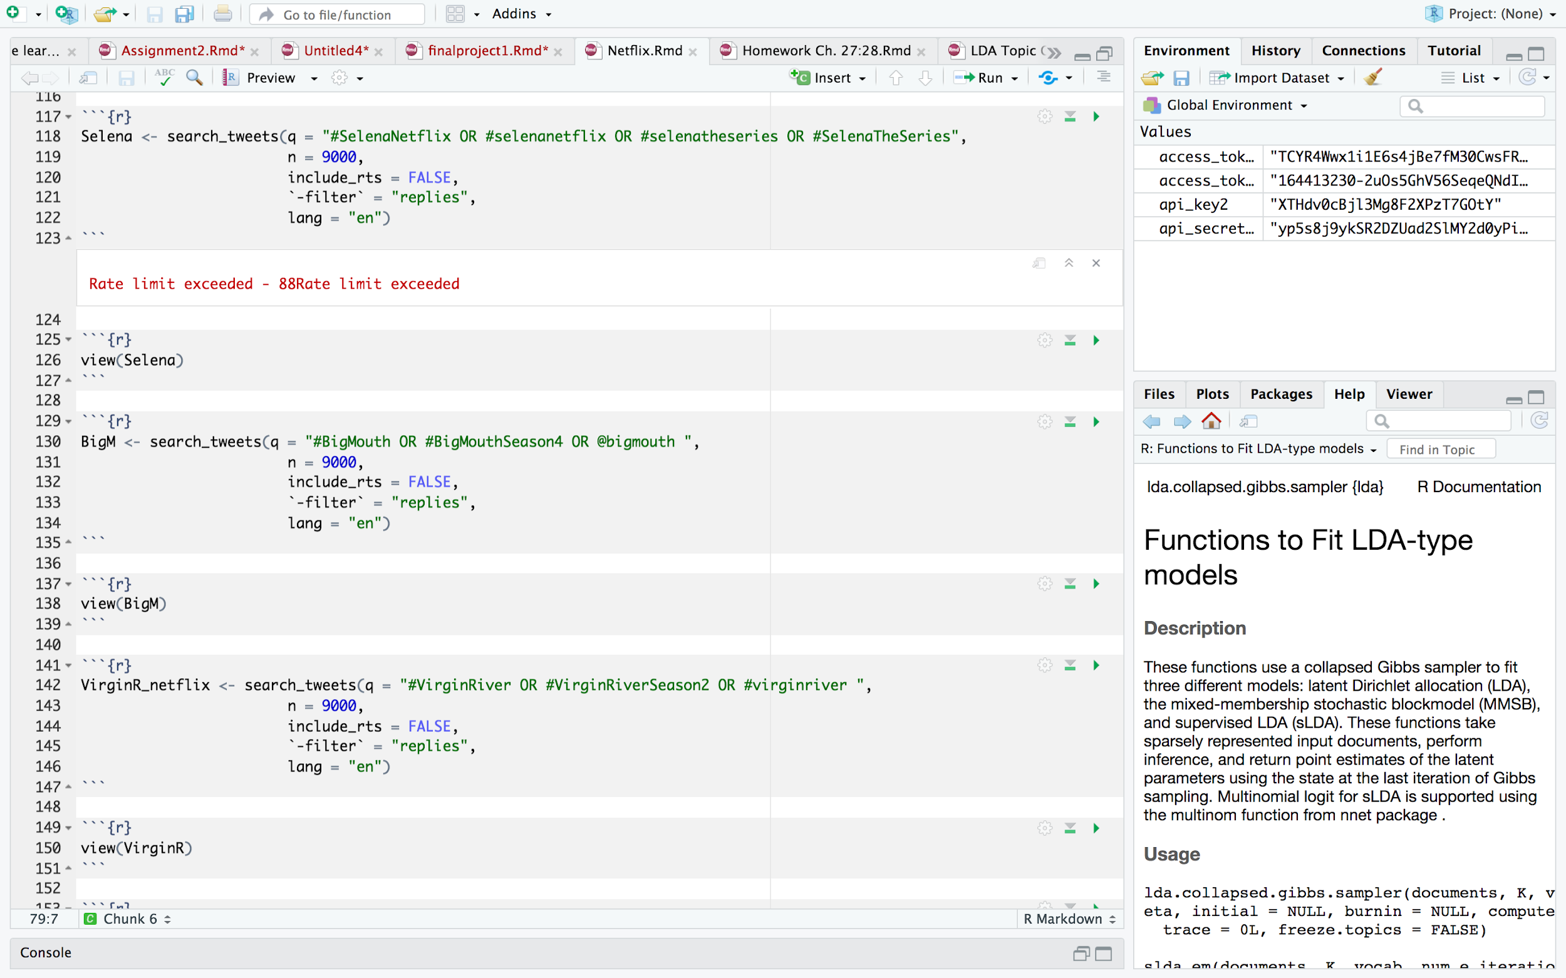
The
Code

Slide 13
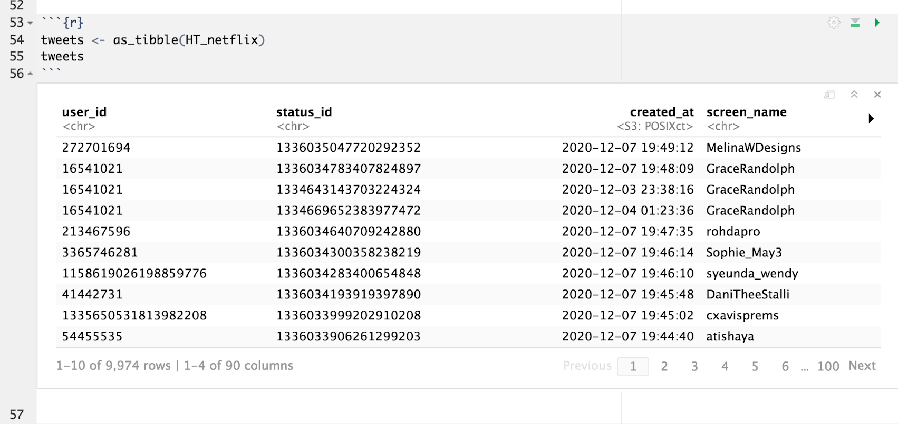
Importing the Collected Data

Slide 14
Counting the Data
Top 10 in U.S, Saturday, December 5th, 2020
8,976 tweets
6,047 tweets
6,321 tweets
28 tweets
7 tweets
8,543 tweets
352 tweets
563 tweets
9,000 tweets
1,079 tweets

Slide 15
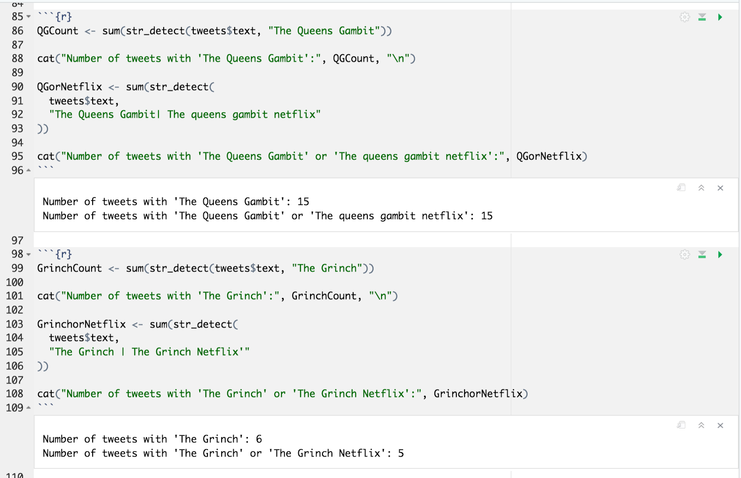

Slide 16
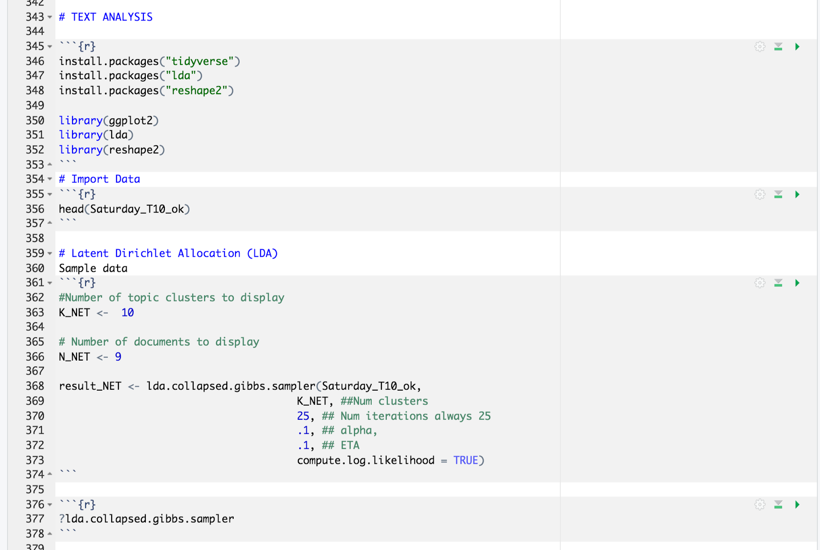

Slide 17
Summary of the Data
Type of Tweets
Tweet Origins
Commonalities
Sentiment Analysis

Slide 18
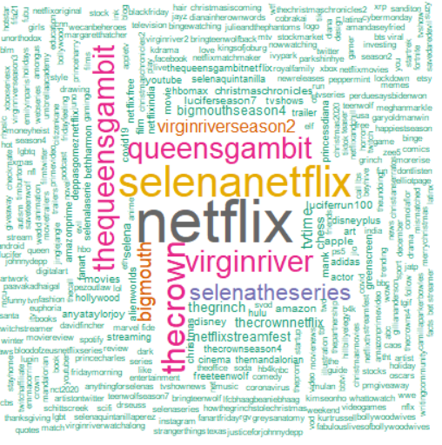
Main Hashtags and Mentions
The most common hashtags and mentions fall under:
Netflix - general
Selena
The Queen’s Gambit
The Crown
Bigmouth
Virgin River
5/10 of the top 10 titles in the U.S.

Slide 19
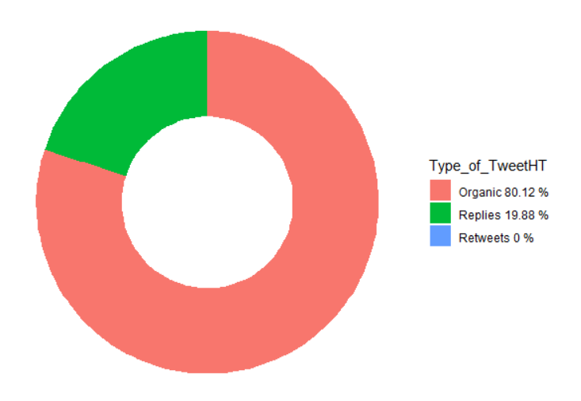
Type of Tweet
80% of tweets are organic
Almost 20% of tweets were replies to organic tweets
No retweets

Slide 20
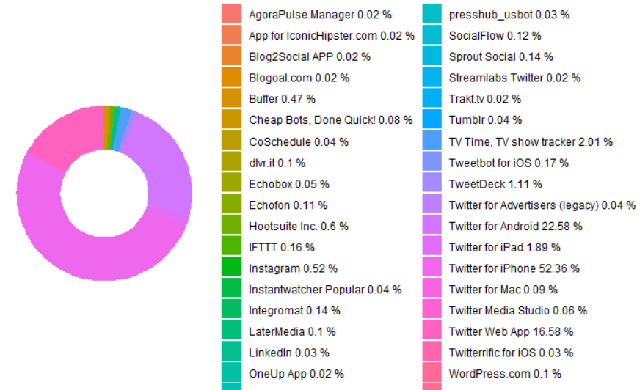
Tweet Origin
Twitter App for Iphone, Android, and Web are the main tweet sources.
Other external recognized apps like Hootsuite, LinkedIn, and Instagram don’t bring as much traffic

Slide 21
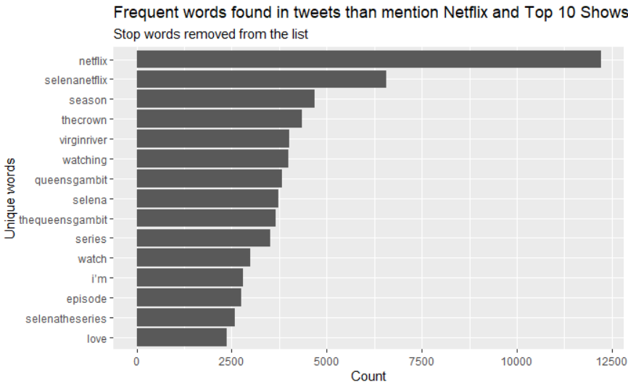
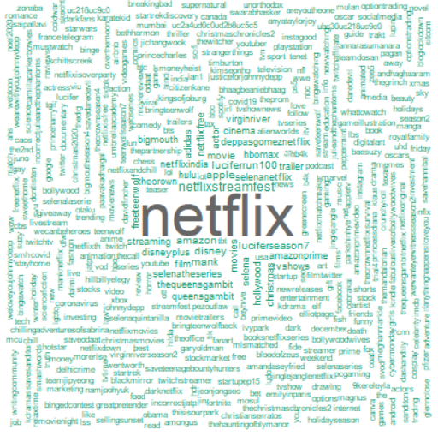
COMMON WORDS & HASHTAGS

Slide 22
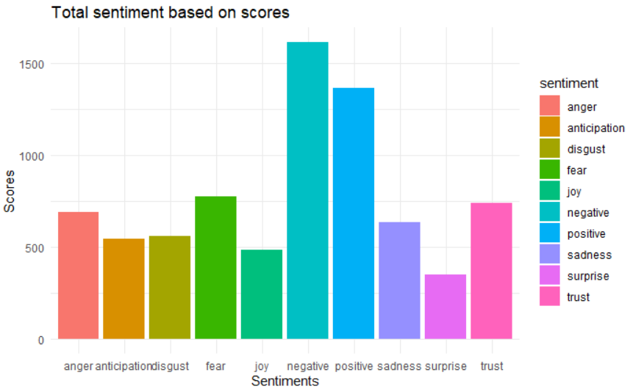
Total Tweets Sentiment
Negative was the sentiment with highest score with more than 1500
The second highest sentiment was positivism with a score less than 1500 but almost
The lowest sentiment was surprise with a score of less than 500

Slide 23
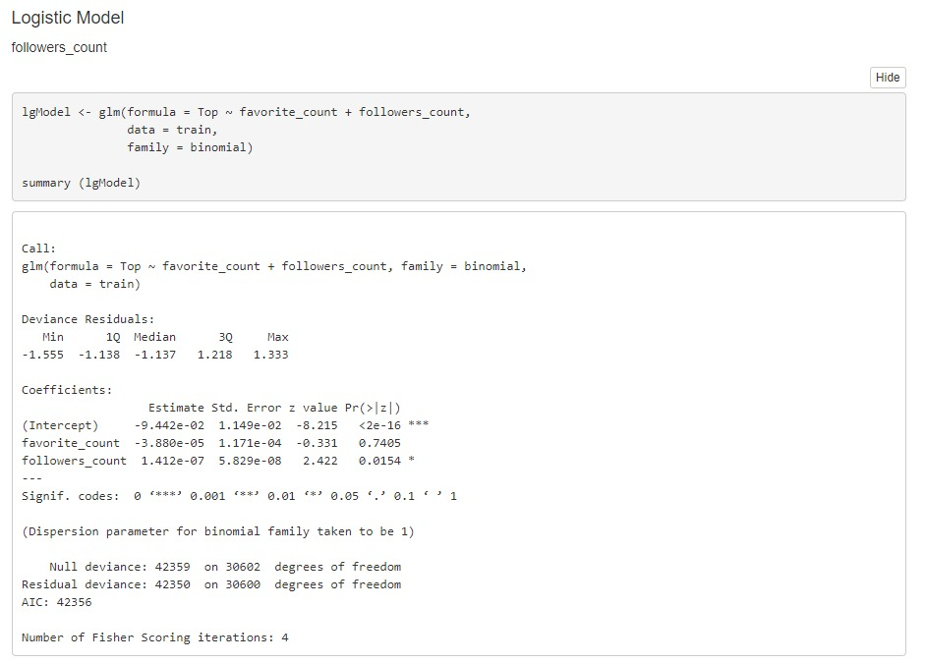
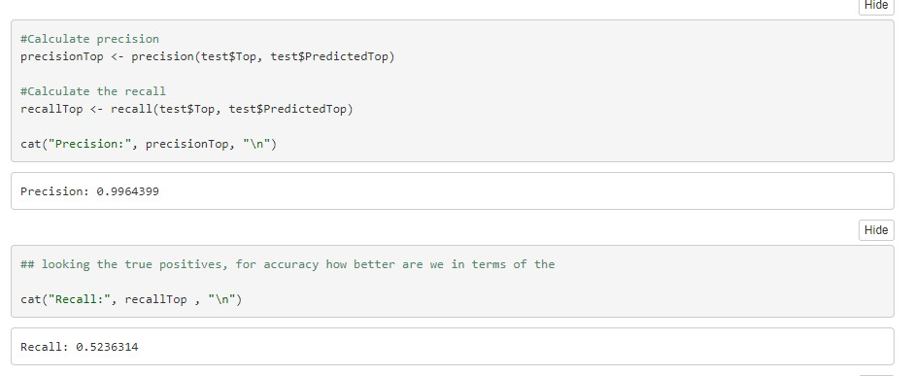
Logistic Regression
Precision: 0.9964
Recall: 0.5236

Slide 24
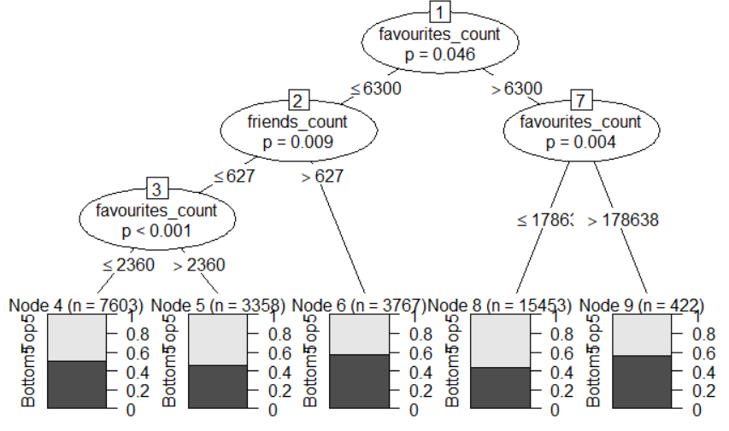
Decision Tree
Top picks by our decision tree: Favourites_count and Friends_count.

Slide 25
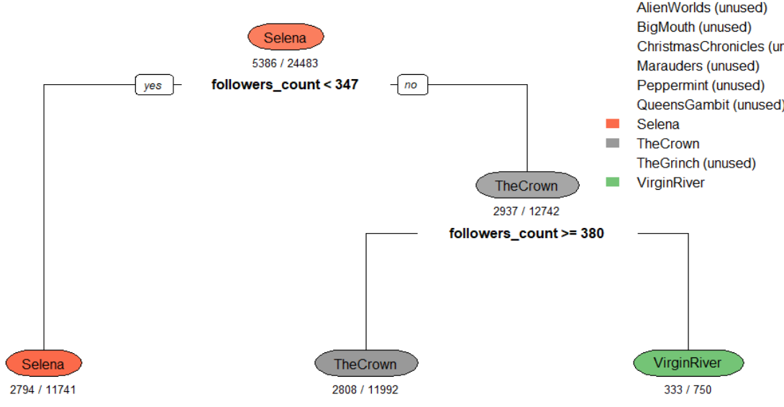
Decision Tree

Slide 26
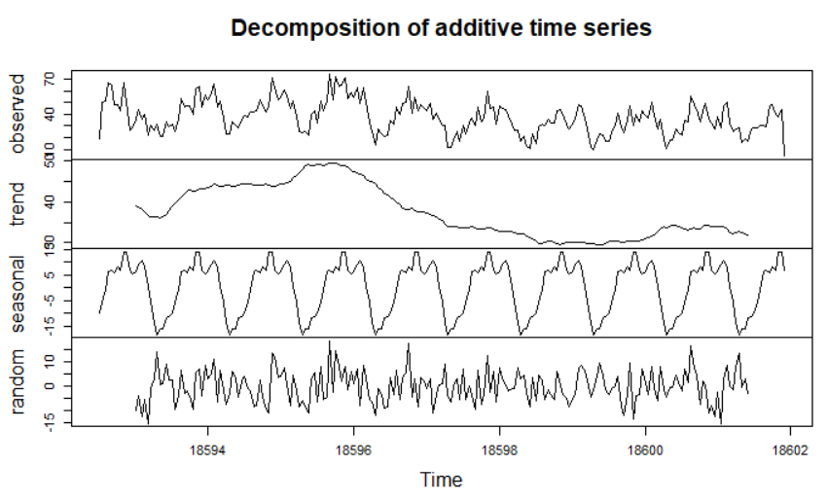
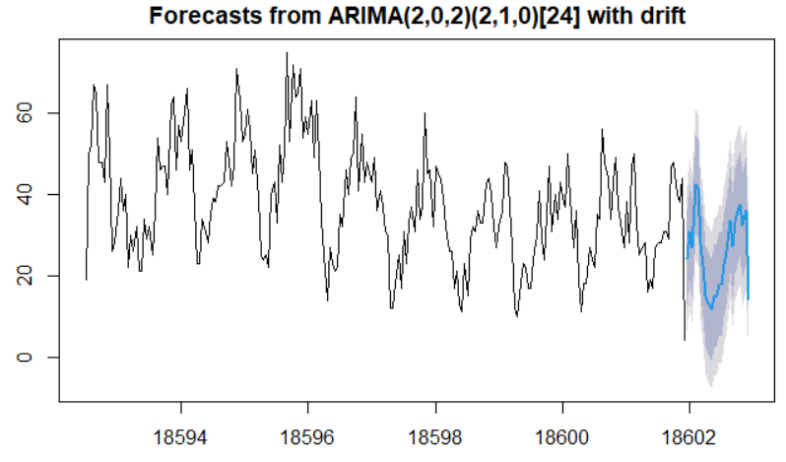
Time Series

Slide 27
Time Series

Slide 28
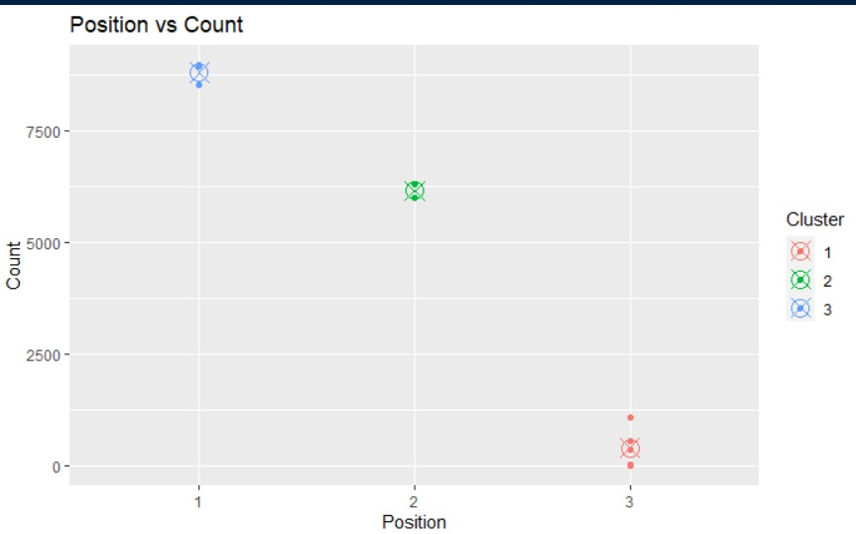
Clustering

Slide 29
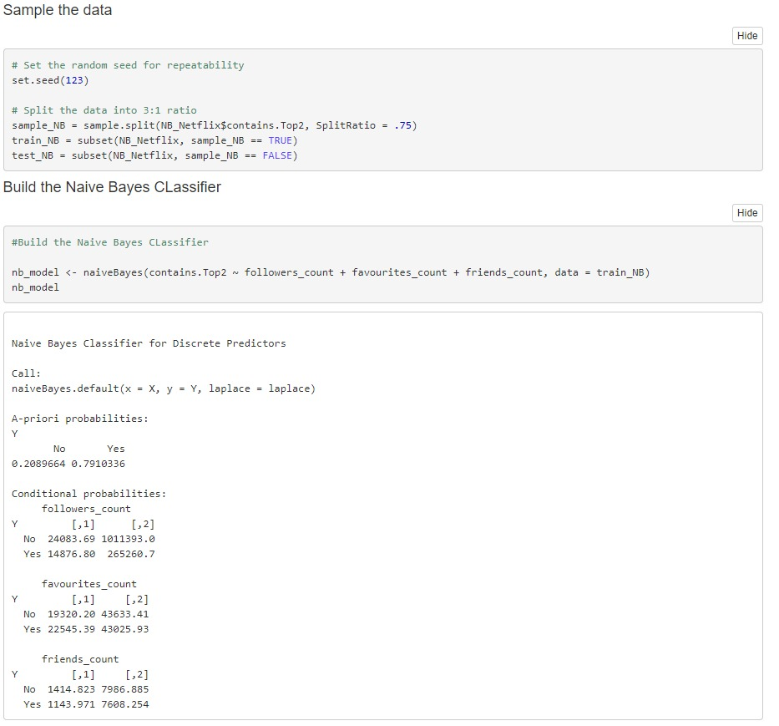
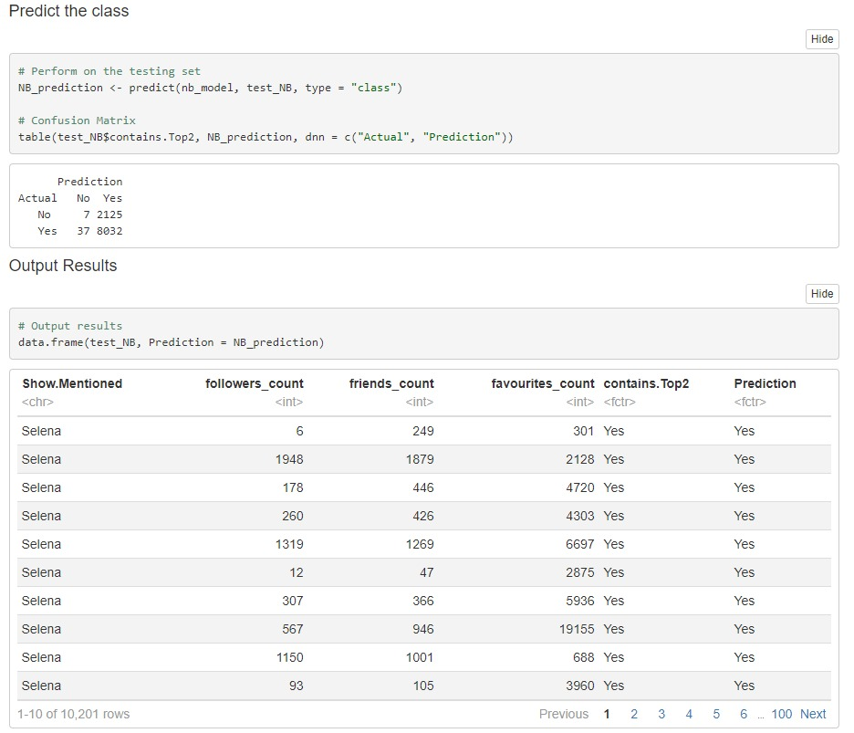
Naive Bayes

Slide 30
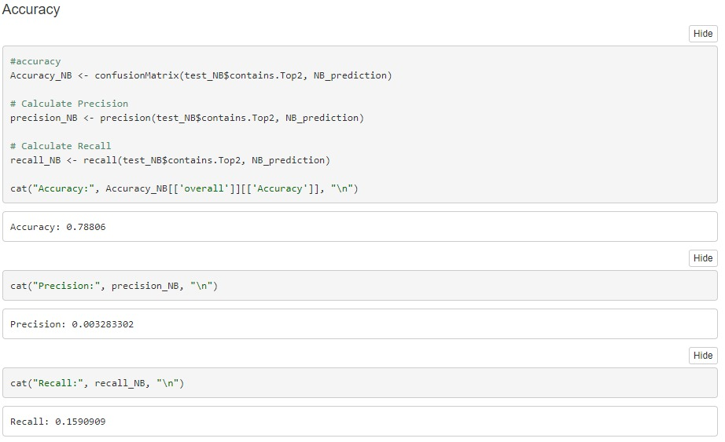
Accuracy

Slide 31
Conclusions
Netflix Top 10
- Only some titles fit with position and twitter presence
- Multiple titles with little to no twitter activity

